Slide 1
Independent Environmental Review of the Beresford Reserve Brownfield Redevelopment Proposal
Completed for the City of DeLand, Florida
By Pegeen Hanrahan, P.E., Community and Conservation Solutions, LLC
And Greg Self, P.G., Terra-Com Environmental Consulting, Inc.
January 31, 2022

Slide 2
This Brownfield Redevelopment Proposal has Multiple Decisionmakers
Landowner and Developer Decisions (Current and Future)
Florida Department of Environmental Protection Decisions
(Mostly Future)
City of DeLand Decisions (Current and Future)
There are Environmental, Economic and Community Conditions All Must Work Within

Slide 3
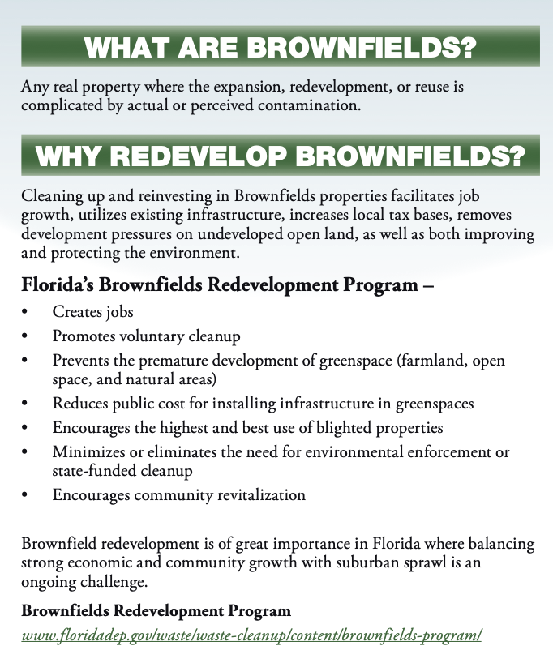
Florida Department of Environmental Protection (FDEP) is responsible for administering the Florida Brownfields Program, including overseeing the investigation of the site conditions and remedial action. FDEP has the capacity to restrict the uses allowed on different parts of a site. Local governments and citizens have the right to access any public records associated with site work and cleanup and have the right to seek to ensure that the remedial actions are protective of human health and the environment. Residential development and the relative proximity of the city’s public water supply will likely drive the site investigation and remedial action for this site.

Slide 4
We are very early in the Brownfield Process, but Residential Site Use Will drive Cleanup Target Levels
Site specific cleanup target levels are determined by FDEP after full site evaluation, taking into consideration the ultimate use of the land. Residential use requires the highest cleanup standards.
Remaining steps in the process include (at a minimum):
Review/comment by FDEP of 12/27/21 Site Assessment Report (within 60 days of receipt)
Remedial Action Plan (within 90 days of approval of SAR)
Initiation of Operation of Active Remedial Action (within 120 days of RAP approval
Post Active Remediation Monitoring Plan
Site Rehabilitation Completion Order (when conditions met)
This is all open to public review, city may provide input, Brownfields Committee must be provided copies, and given the opportunity for input.

Slide 5
Brownfield Cleanups Address Long-term Problems
The Brownfield Program provides a system for voluntary cleanup to put a site back into a condition appropriate to its desired use. The intent is to allow a party that did not create or contribute to the contamination to remediate it. The developer/owner are not otherwise responsible for site cleanup, can terminate the Brownfield Site Rehabilitation Agreement, or could transfer the BSRA.
There is a benefit to the community that a private party has come forward to both investigate the extent of contamination and remediate it to a safe end point.
FDEP has authority to restrict some uses and location of features onsite as part of its review and approval of the Remedial Action Plan.

Slide 6
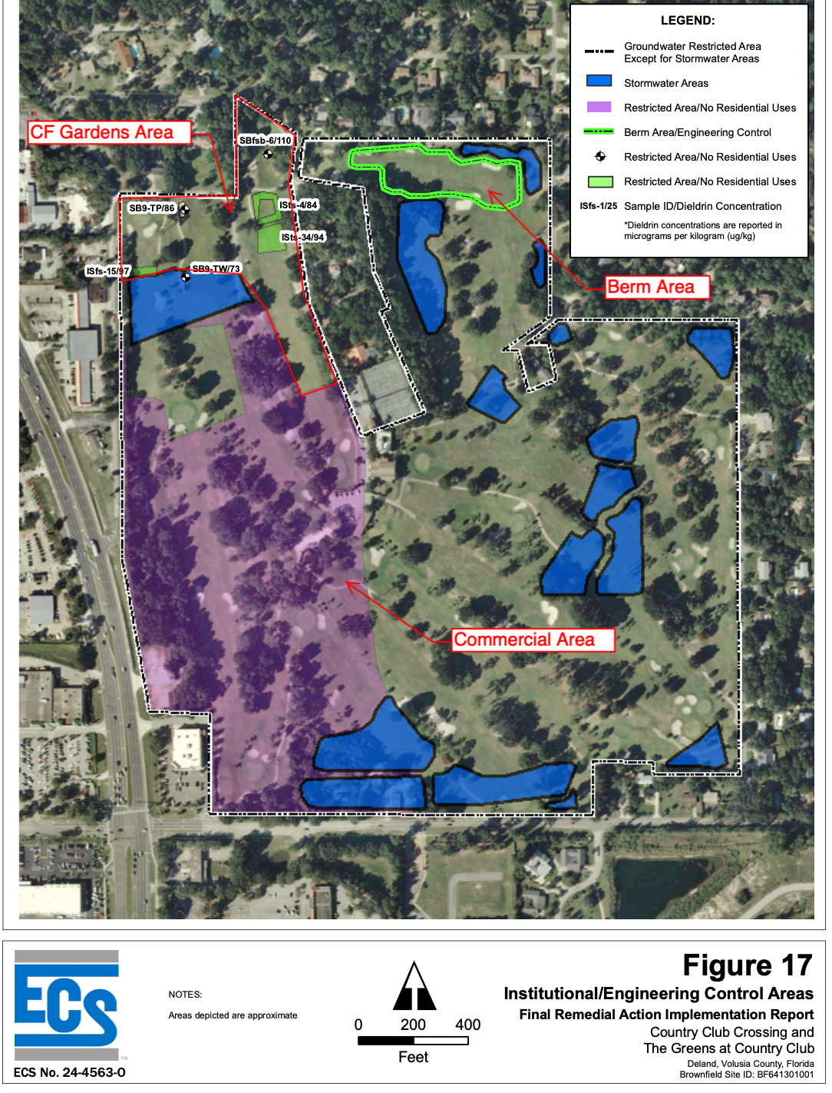
Example of Brownfield Site Land Use Restrictions in DeLand from Florida Department of Environmental Protection

Slide 7
Known Concerns
There should be additional test wells in both the surficial and Floridan Aquifer and also additional soil testing to fully assess the site conditions.
There is a potential for airborne contamination when the site is excavated, and other remedial action work occurs, so there should be explicit dust and site safety controls in place to protect workers and the community.
The main conditions that will drive the extent of cleanup are the plans for residential development (soil), and nearby private and municipal drinking water wells (groundwater). There hasn’t yet been testing in nearby private wells as far as we are aware.
There is relatively little known about the dump area. Onsite work indicates it was used primarily for construction and demolition debris disposal, but some citizen testimony indicates it may have been used for municipal or industrial waste. There is likely more unknown about this part of the site than the golf course areas. Many golf courses have been remediated and redeveloped successfully with similar contaminants onsite, including in Florida.
Citizens have provided evidence of gopher tortoises onsite. The City will require an environmental assessment report for threatened and endangered species. Florida Fish and Wildlife Conservation Commission permitting will be required if the presence of tortoises is verified.

Slide 9
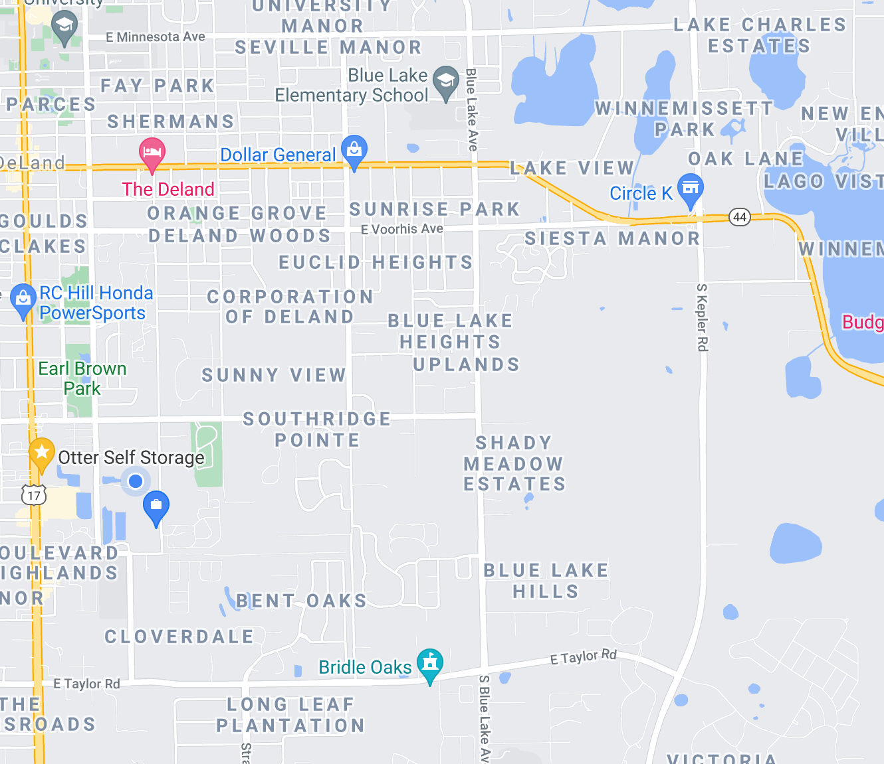
Water Plant #4
Well 6 350’
City drinking water wells are within + 1 mile. There are also 17 known private domestic wells within ½ mile.
Water Plant #6
Well 10 325’
Water Plant #5
Well 9 325’
Subject Site
Water Plant #8
Well 12 320’
Water Plant #9
Well 14 320’
Well 15 320’
Water Plant #7
Well 21 325’

Slide 10
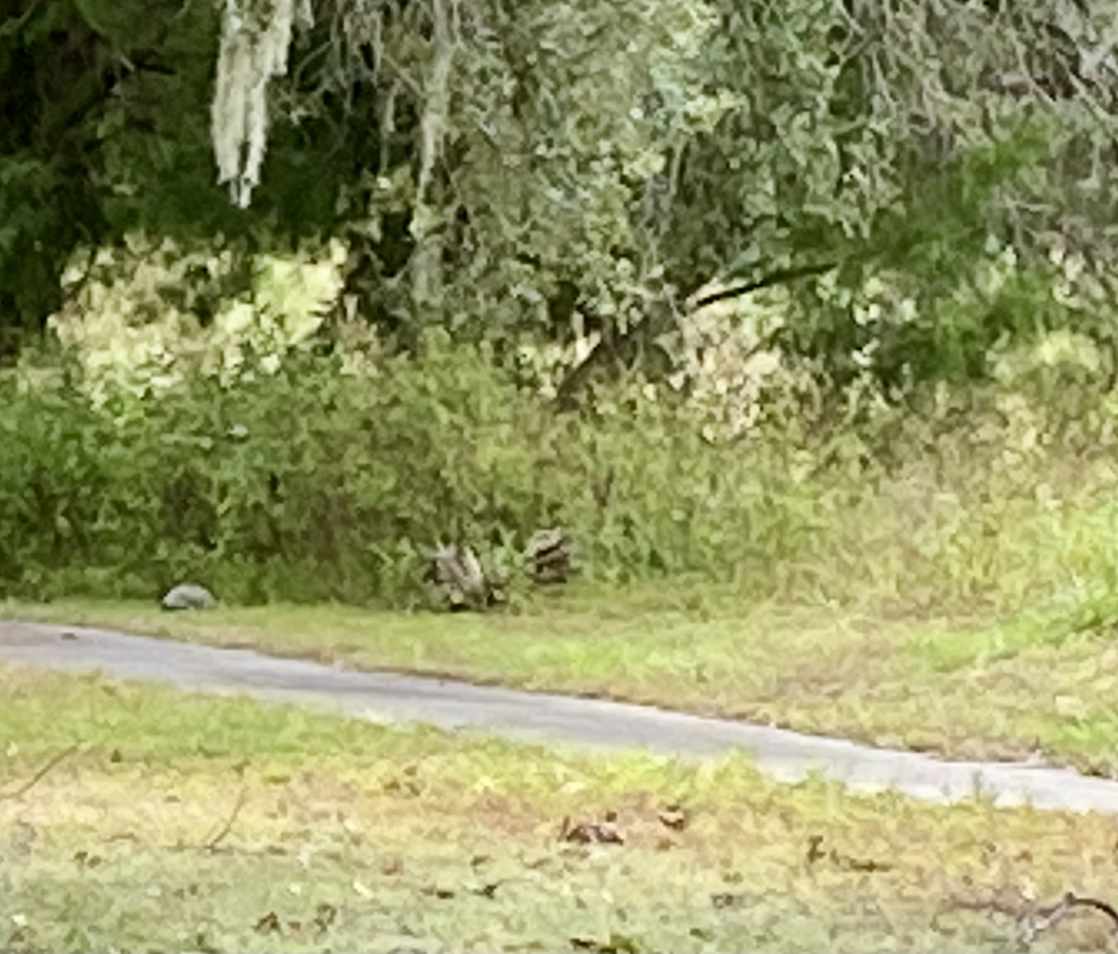
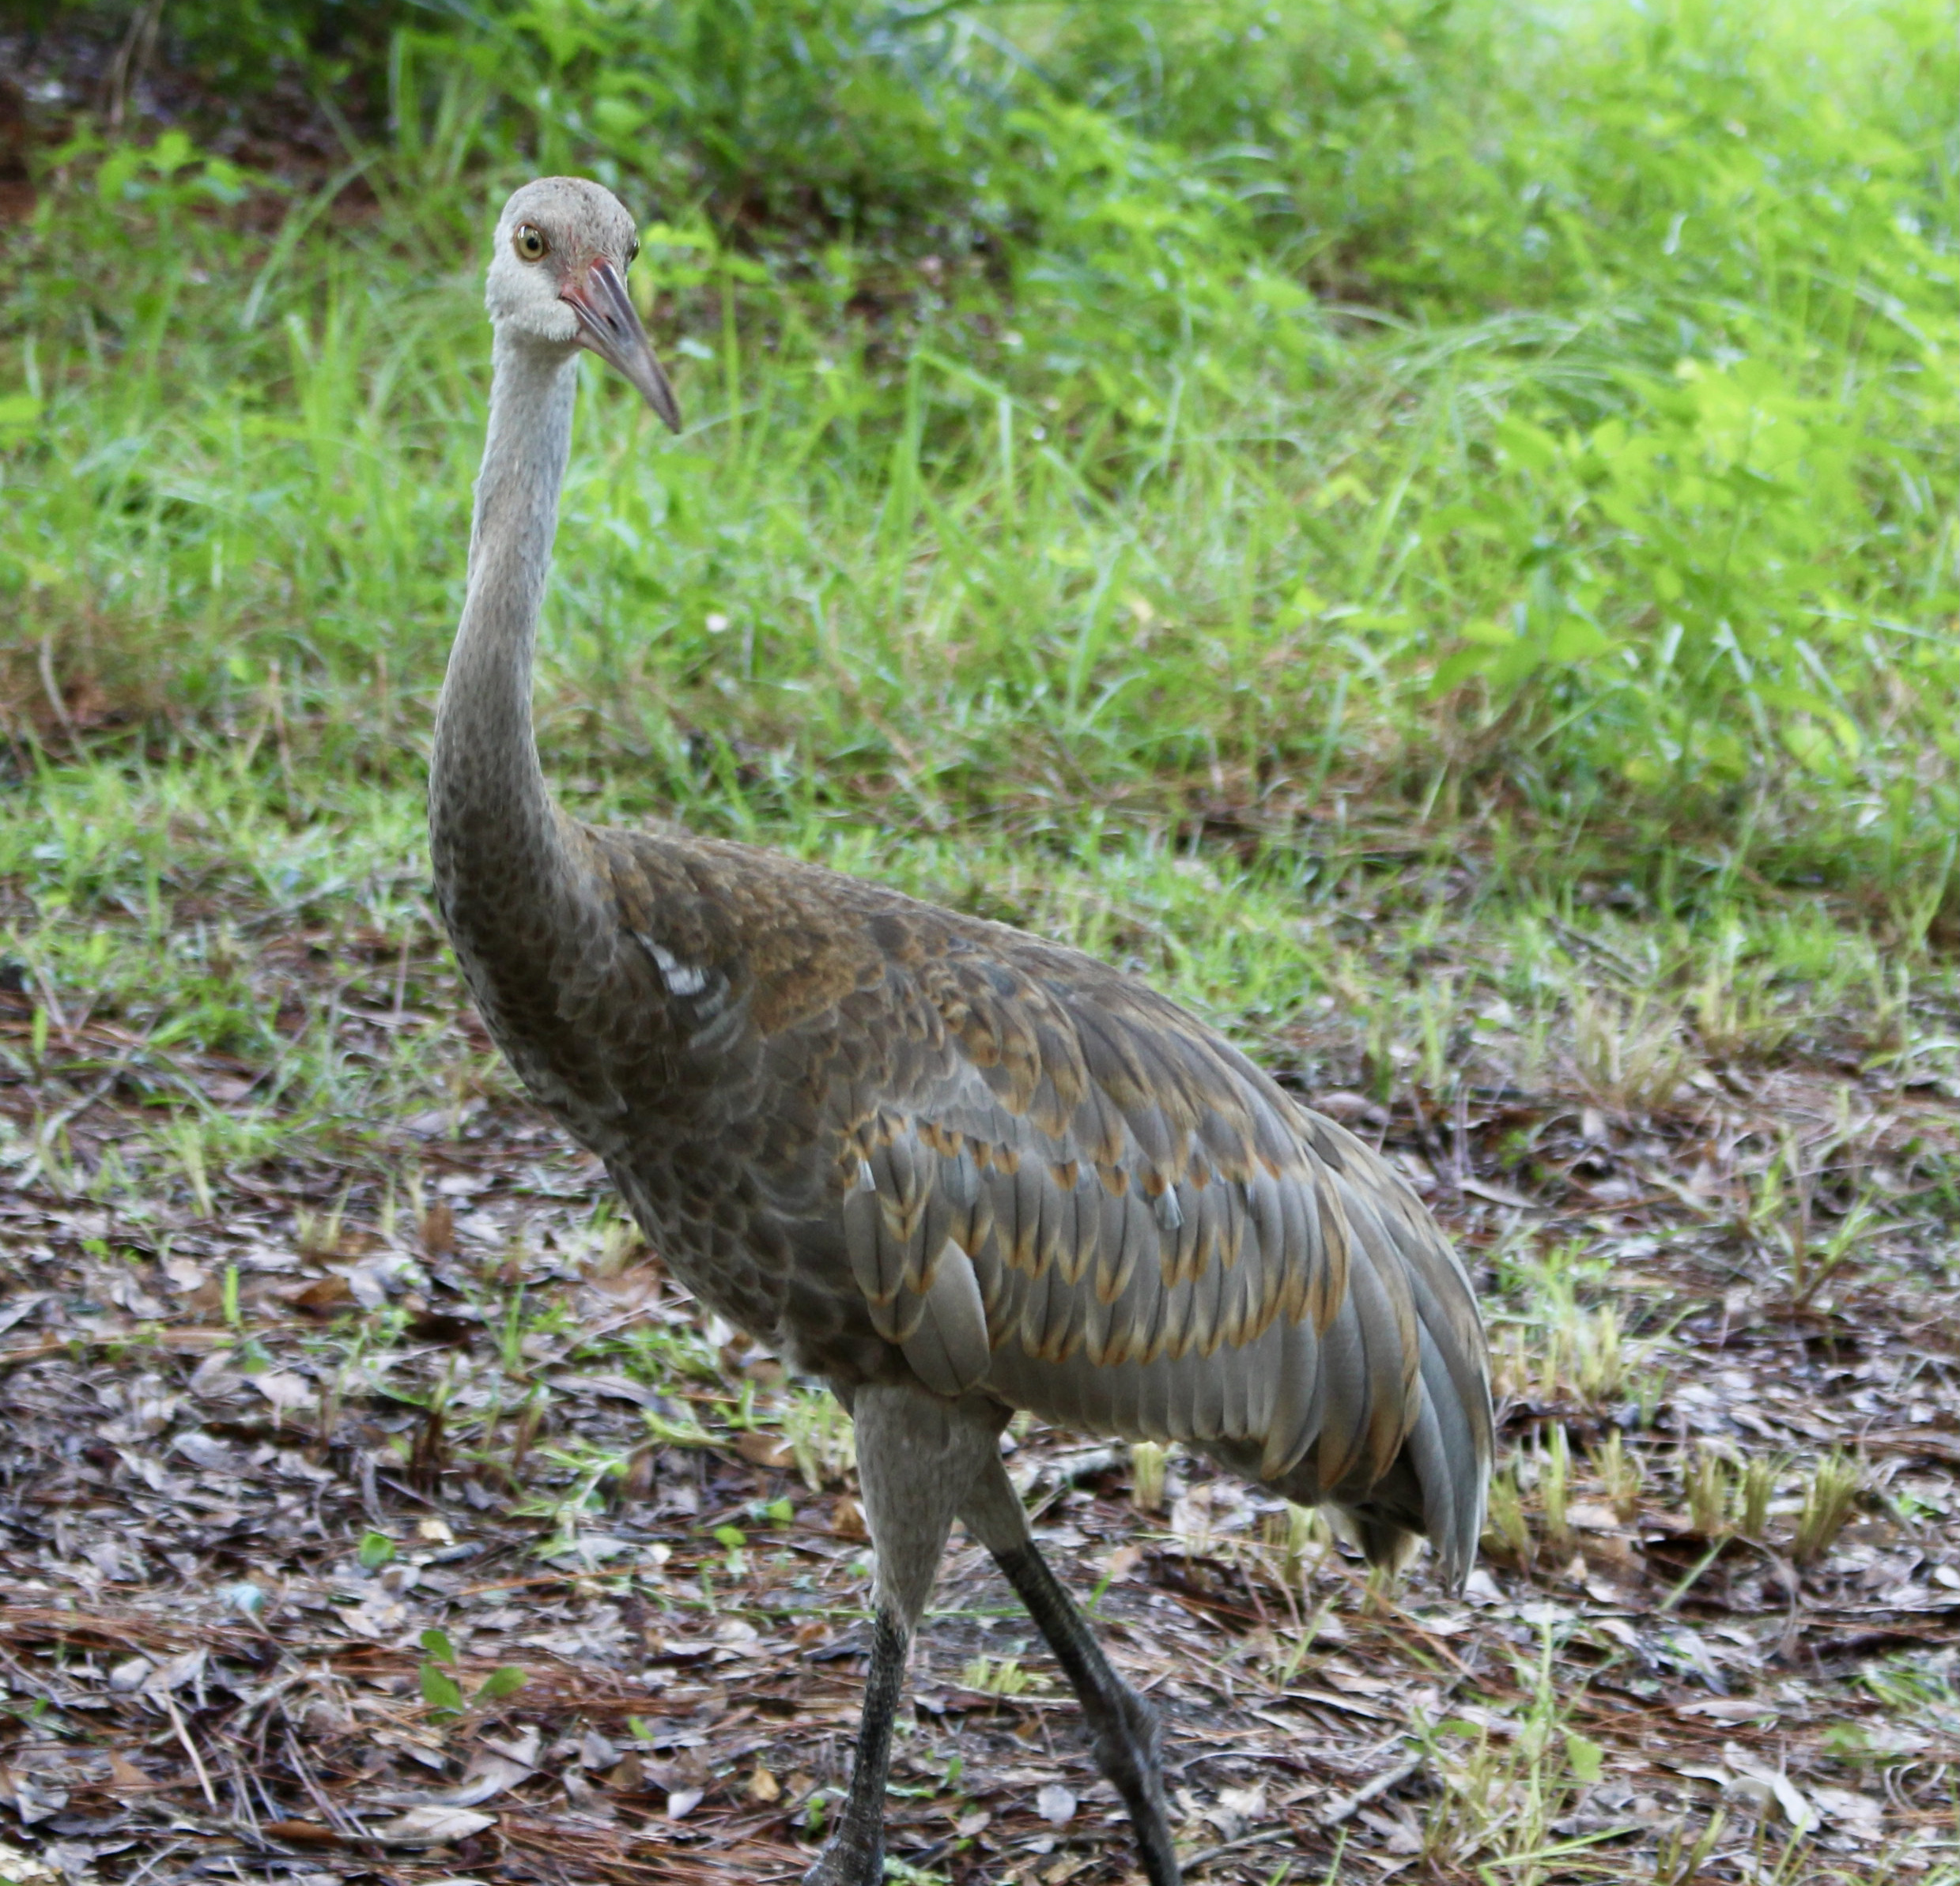
Citizen Input is Valuable, Legitimate Concerns Have been Identified and Should
Be Addressed Regardless of Site Use
Having reviewed much of the citizen testimony, met with contractors for the applicant and some representatives expressing community concerns, it is important to acknowledge the benefit of having many eyes on the site and the process. It speaks well of the City, the community and the applicant that there is a lot of work and thought going into the decision-making.
Examples of Legitimate Issues: Concerns about dust control/contaminant pathways during construction; Concerns about unknowns associated with former dump area; Concerns about health effects of contaminants; Identification of gopher tortoises and other species onsite.
Images of Gopher Tortoise and Sandhill Crane onsite provided by
Martha Shaw-Sylvester

Slide 11
Recommendations/Conclusions
Request that FDEP require installation of at least one Floridan Aquifer test well onsite, and at least one sentinel well between this site and the public wellfield. These should be completed at the same interval as the municipal wells and constructed to minimize opportunity for cross contamination.
Require site controls during remedial action and excavation that minimize opportunity for airborne exposure.
Prohibit mixing of soil as a method to reduce average contaminant levels.
Require clean fill, that has been tested at the source per FDEP guidelines, in the top two feet within residential areas that are not capped with FDEP-approved engineering controls such as asphalt, concrete or buildings.
Remain flexible in the site plan and location of onsite features, uses and amenities so that areas that should not have residential development may be freely designated by FDEP.
FDEP will require additional research and testing of onsite conditions for both the golf course areas and the former dump prior to finalizing the remedial action plan.
The brownfield status of the site does not prohibit changing zoning on this site from its existing residential use to a Planned Development with residential and recreational uses. Under ideal circumstances it would be helpful to have the site fully characterized and the remedial action plan completed prior to zoning, but FDEP retains the ability to limit development in some areas or for some uses if warranted. Were the developer to abandon the project, remediation would be delayed and a new party to complete it would need to be found. Residential use will require higher cleanup standards than recreational, commercial or industrial would.
Consider appointing a site-specific Brownfield Committee of residents, business owners and others with specific interests and expertise to guide oversight of this project on behalf of the city.
Regardless of tonight’s outcome, as a proactive and precautionary step the City should request that the County Public Health Department offer water quality testing for any private drinking water wells in the immediate area.

